Slide 1
Internet & Web Technology Lab IT-604

Slide 2
Done by: Group No. 22
Naman Kumar Soni. Roll No. 13/IT/20
Prerona Dutta. Roll No. 13/IT/57
Sudhanshu Singh. Roll No. 13/IT/63
Nisha V Prasad. Roll No. 13/IT/90

Slide 3
13 January, 2016:
Class Lecture:
The class lecture mainly dealt with the rules and regulations of the internet and web technology lab. The lecture also dealt with goal of the lab sessions and how to execute the activities towards fulfilling that goal.
Goals for the coming sessional class: 20thJanuary
To create the front page of a students portal using HTML (Hypertext Markup Language) and CSS(Cascading Style Sheets).

Slide 4
Goals achieved: 20thJanuary We have been successful in creating the Home page of a Students’ Portal, using HTML, which has the links for following options: 1.Administration Login(Admin Login) 2.Student Login 3.Student Registration The Student Login link further leads to a form which has the following fields to be filled and then submitted: 1.Username 2.Password

Slide 5
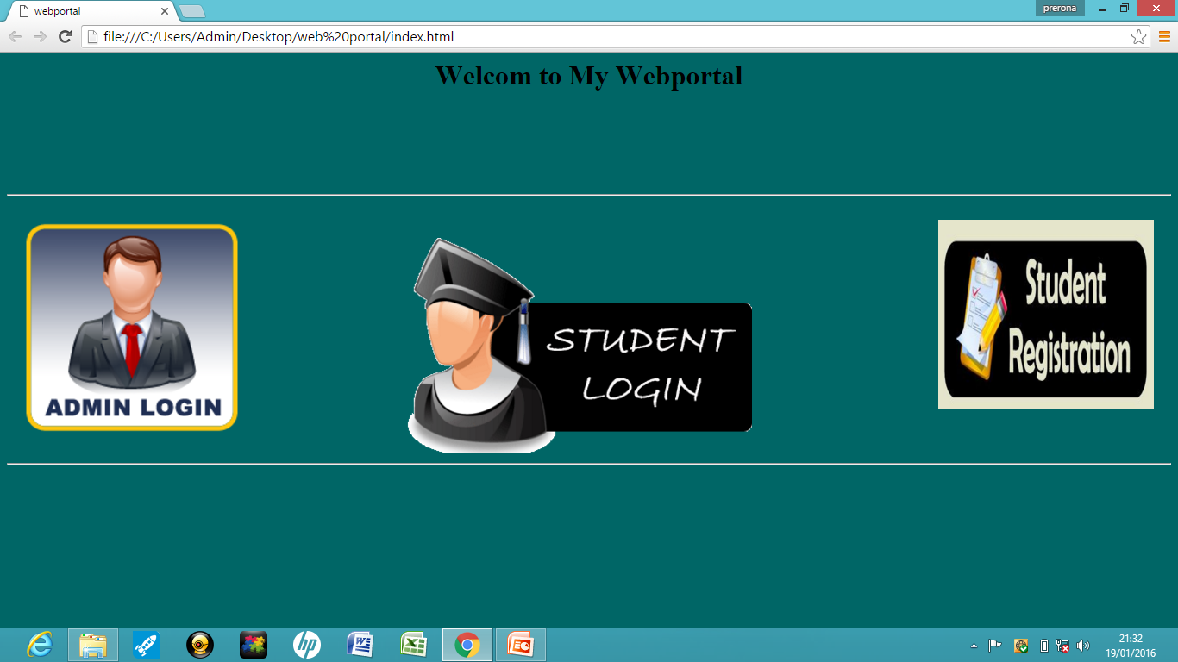
Page No. 1:
Home page of our Web Portal

Slide 6
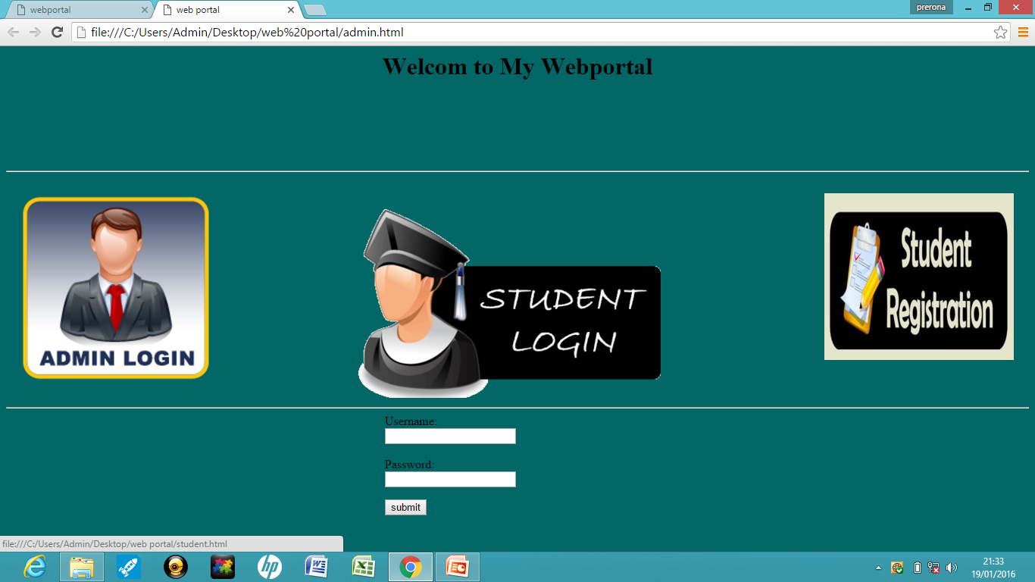
Page No. 2:
Admin Login Page of our Web Portal

Slide 7
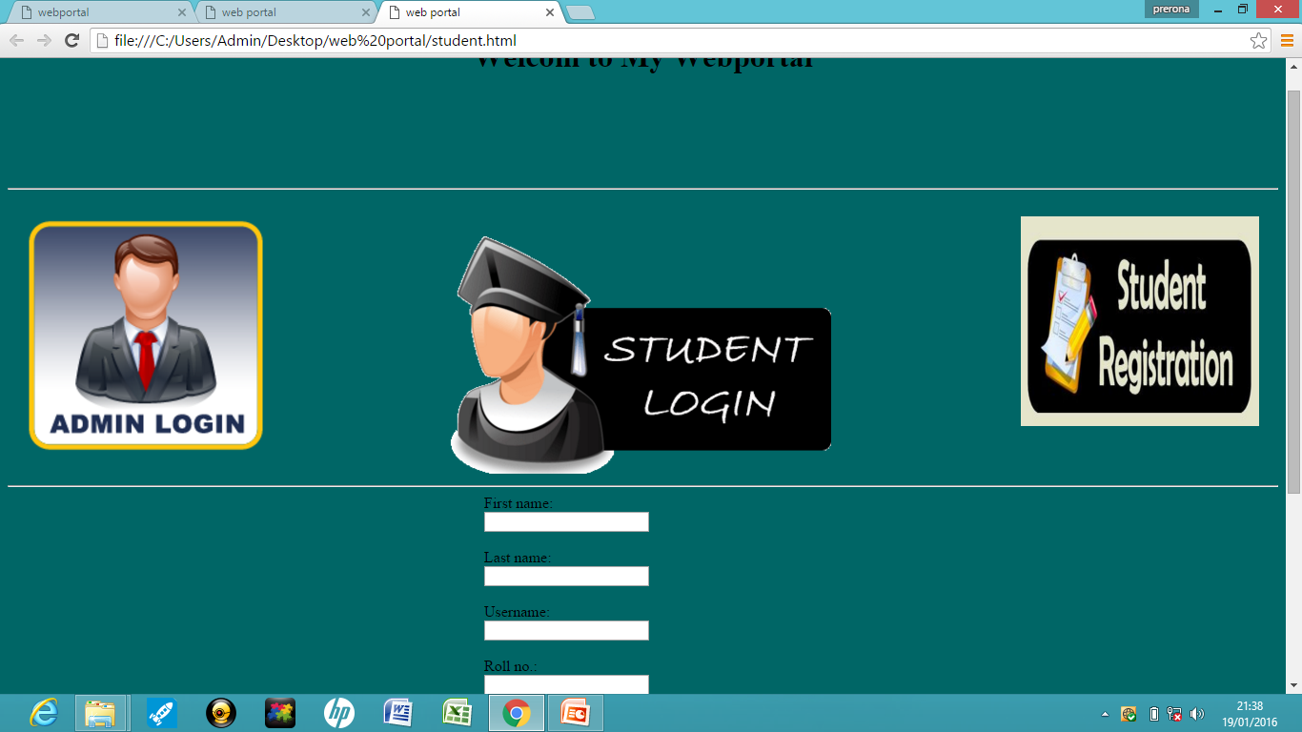
Page No. 3:
Student Registration Page of our Web Portal.

Slide 8
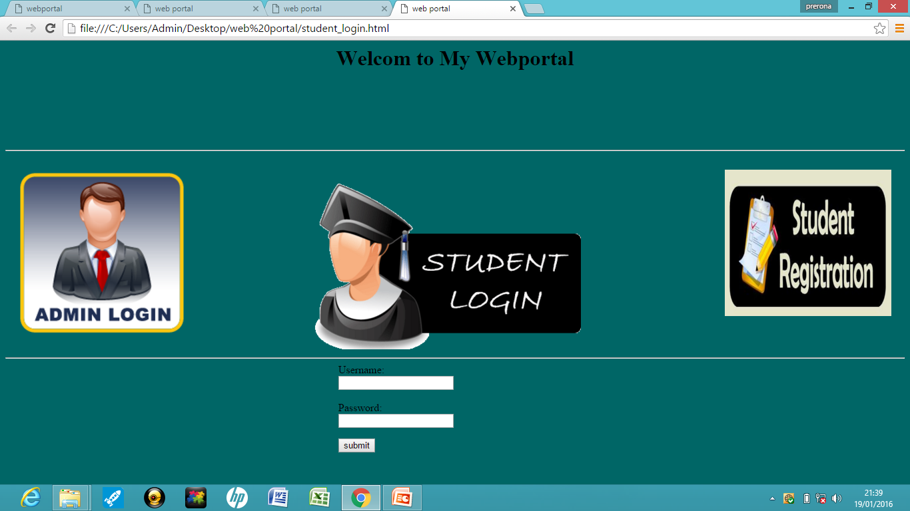
Page No. 4:
Student Login Page of our Web Portal.

Slide 9
Goals for the upcoming sessional class: 27thJanuary
To develop further on the webpage(portal) by adding forms and developing more on the backend functionings (such as connectivity by the help of PHP and validation by Javascript)...

Slide 10
27th January
Goals achieved:
Features added to the Student Registration form
Calendar added for date of birth
Dropdown box created to select Department of students.
Auto-generated Roll Number.
Hobbies field added in the form of Check-boxes.
Form validation using Javascript.
Overall layout of the pages are modified.

Slide 11
Work Division
Webpage designing:
Naman Soni – Student Registration Page and Designing
Nisha V Prasad – Student Login Page
Sudhanshu Singh – Admin Login Page
Prerona Dutta – Homepage and designing and Presentation.

Slide 12
Goals for the Upcoming Sessional class: 3rd February, 2016
To create Linking to the database using PHP and MySQL and also bring in further modifications to the webpage layout.

Slide 13
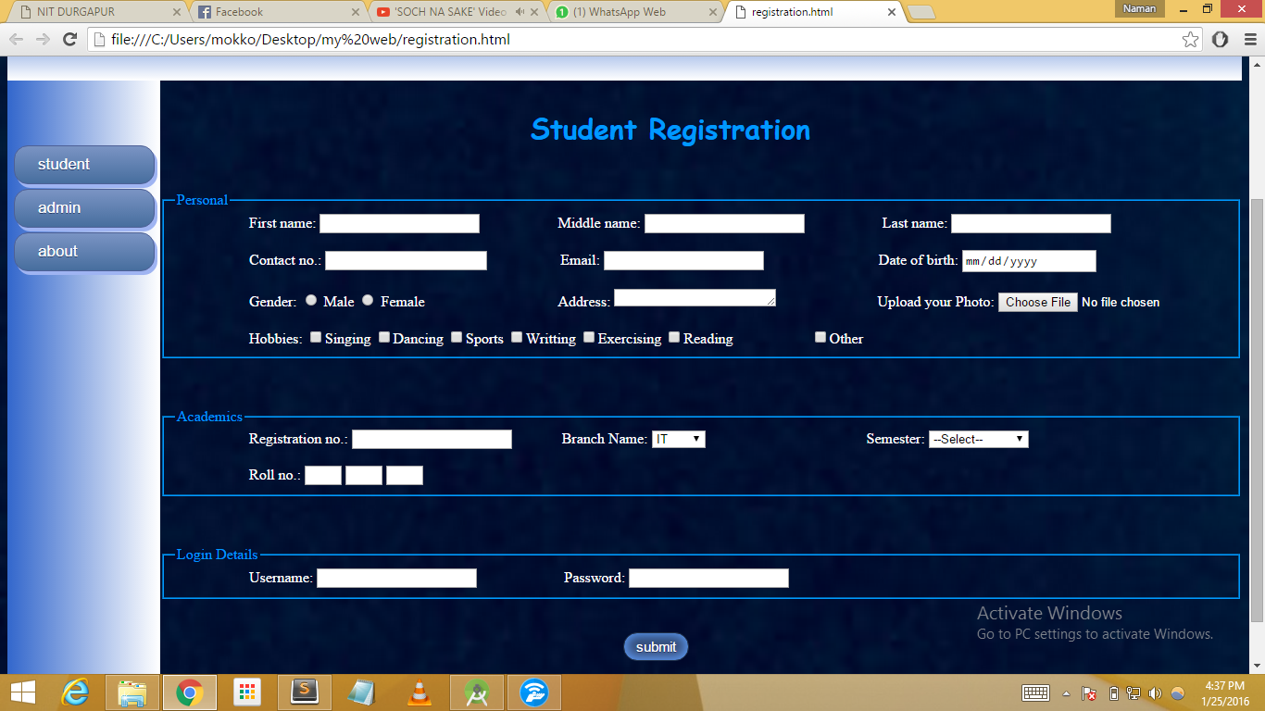
Screenshots of the pages: Student Registration:

Slide 14
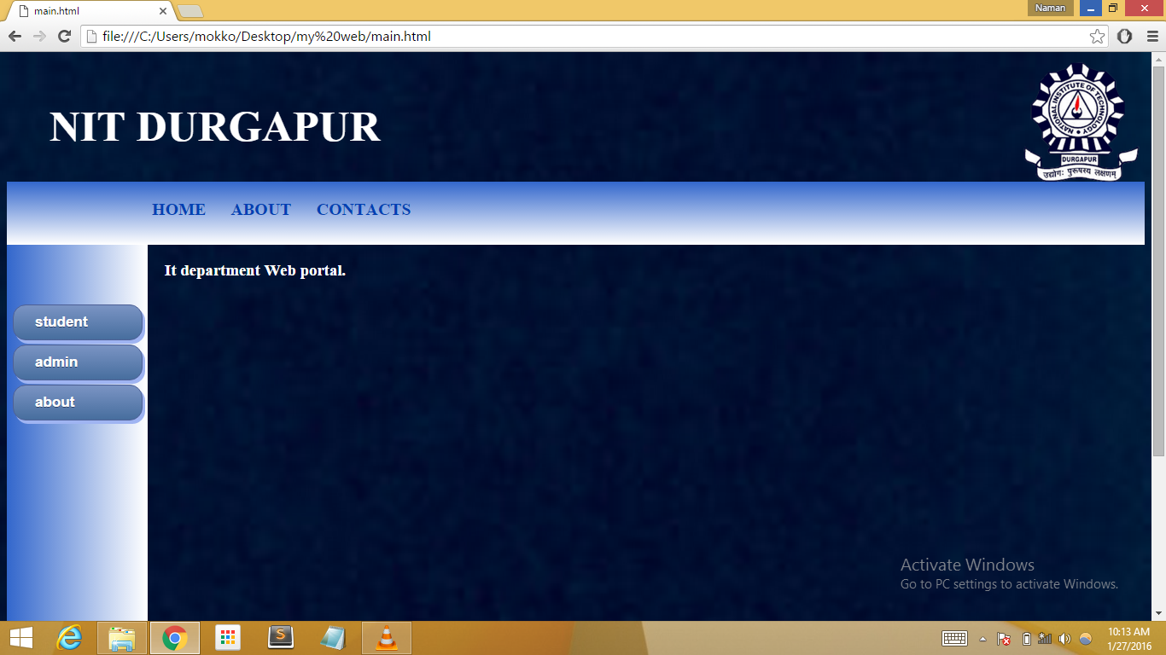
Home page:

Slide 15
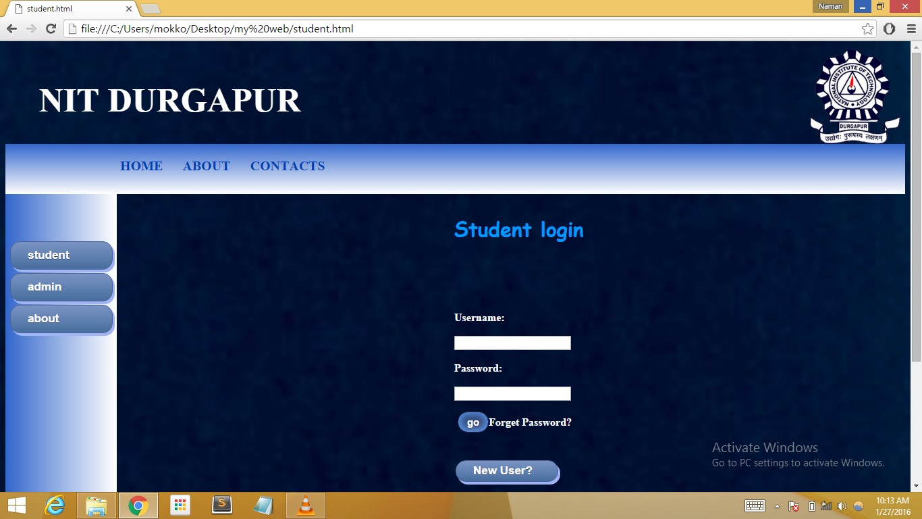
Student Login page:

Slide 16
Student Login page:

Slide 17
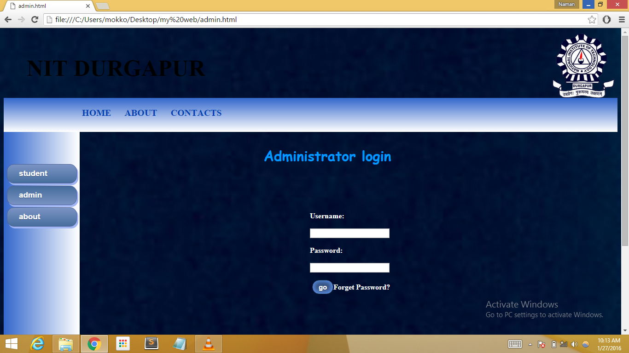
Aministrator Login

Slide 18
10th February
Goals achieved:
Backend developments are done to the Student Registration form:
Connection with the MySQL database is established.
Data entry is validated in all fields and the data is stored in the MySQL database.

Slide 19
Work Division
Webpage designing:
Naman Soni – Student Registration Page backend development and MySQL database developments.
Nisha V Prasad – MySQL database developments
Sudhanshu Singh – Student Registration Page backend development and designing.
Prerona Dutta – Designing modifications and Presentation

Slide 20
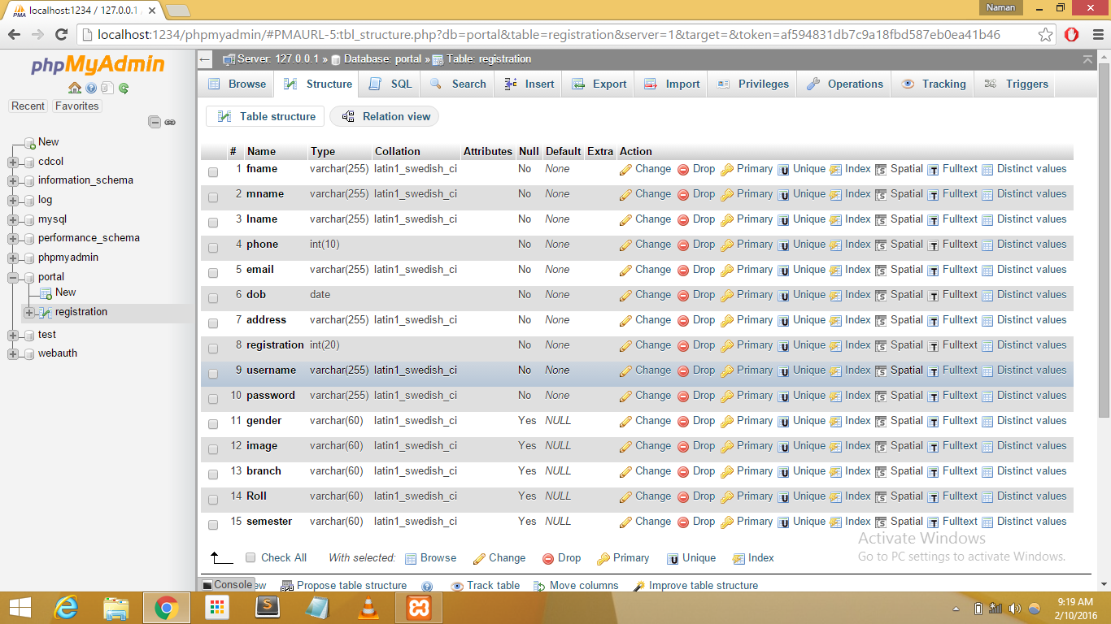
Table structure of Database:

Slide 21
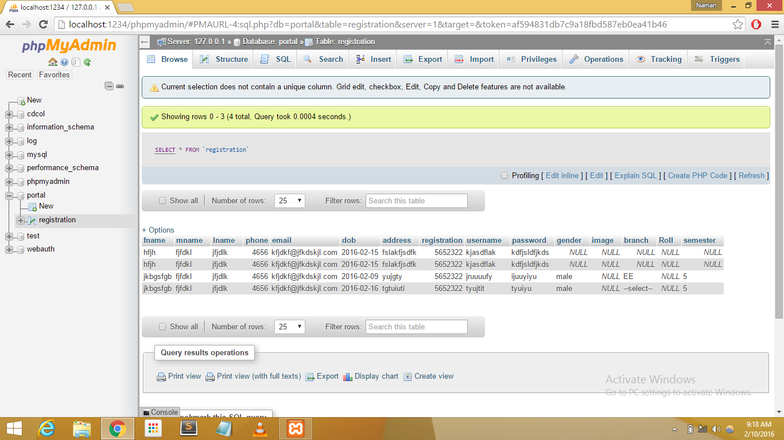
Example of a Table:

Slide 22
Goals for the Upcoming Sessional class: 17th February, 2016
To create backend developments to the Admin Login (CMS) page which include data entry and data storage to MySQL database.

Slide 23
References:
W3schools.com

Slide 24
THANK YOU...

